Slide 1
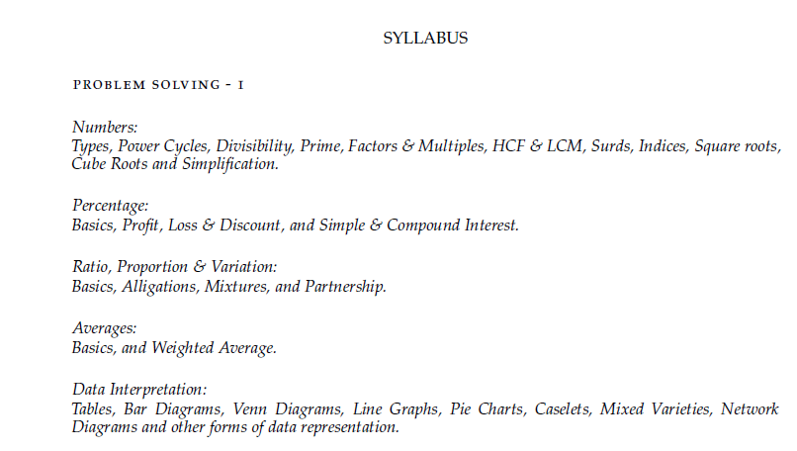

Slide 2
Section : Numerical Aptitude Topic : Number system Sub topic : Finding the unit digit
What is a Unit Digit?
Unit digit of a number is the digit which is in the ones place of a number. For example , the units digit of 243 is 3 , the units digit of 39 is 9.
If the power is a larger number then we should use cyclicity to find the unit digit.
Cyclicity:
When performing certain mathematical operations from the smaller value or smaller power we will be able to find a specific pattern which will be followed. We need to crack the pattern and apply the rule based on the observed pattern. This will be used to solve problems based on unit digit, tens digit, finding the remainder and pattern based problems.

Slide 3
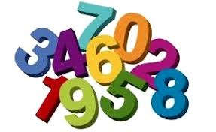
Unit Digit - examples
1. The units digit of 35^87 + 93^46 is:
2. What is the unit digit in the product (3⁶⁵ x 6⁵⁹ x 7⁷¹)?

Slide 4
Unit Digit Patterns
0
1
2
3
4
5
6
7
8
9
Group 2 – 4,9
4^1 – 4 , 4^2 – 16 ,4^3 – 64 , 4^4 – 256….
We can find a pattern we have 2 cycles.4 power odd number unit digit will always be 4, 4 power even number unit digit will always be 6
Same way for 9
9^1 – 9, 9^2 – 81, 9^3 – 729,……..
9 power odd number unit digit – 9 , 9 power even number the unit digit will be 1.
Group 1 – 0,1,5,6
These numbers when raised to any power will give the same unit digit.
For example:
0^121221 = 0
1^ 12121212545 = 1
5^ 787808 = 5
6^ 96385274 = 6

Slide 5
Unit Digit Patterns
Group 3 – 2,3,7,8
2
3
7
8
2^1 – 2
2^2 - 4
2^3 - 8
2^4 - 16
2^5 - 32
There are 4 cycles
2,4,8,6
3^1 – 3
3^2 - 9
3^3 - 27
3^4 - 81
3^5 - 243
There are 4 cycles
3,9,7,1
7^1 – 7
7^2 - 49
7^3 - 343
7^4 - 2401
7^5 - …7
There are 4 cycles
7, 9 , 3, 1
8^1 – 8
8^2 - 64
8^3 - 512
8^4 - …6
8^5 - …8
There are 4 cycles
8, 4 , 2, 6

Slide 6
Unit Digit Patterns
Group 3 – 2,3,7,8
Since group 3 numbers have 4 cycles we cannot split it based on odd and even powers.
Since the value is repeating after 4 cycles we need to separate the multiple of 4 by dividing the power by 4.
If the power is exactly divisible by 4 then choose the 4th value of the corresponding number.
If it is not exactly divisible we will be getting remainders as 1,2 or 3.
If the remainder is 1 choose 1st value.
If the remainder is 2 choose the 2nd value.
If the remainder is 3 choose the 3rd value.

Slide 7
Unit Digit Patterns
0
1
2
3
4
5
6
7
8
9
0
1
2
3
4
5
6
7
8
9
4
9
6
9
4
1
8
7
3
2
6
1
1
6

Slide 8
Unit Digit - examples
The units digit of 35^87 + 93^46 is:
Solution:
35^87 – Here the unit digit is 5 . 5 raised to any power will always be 5
93^46 – Here the unit digit is 3, 3 has 4 cycles so we need to divide the power by 4
46/4 we get remainder 2 so we need to take second value which means 3^2 value = 9
Answer = 5+9 = 14 so unit digit will be 4
What is the unit digit in the product (3⁶⁵ x 6⁵⁹ x 7⁷¹)?
Solution:
3^65 – 65 when divided by 4 remainder 1 so 3^1 value – 3
6^59 – unit digit – 6
7^71 – 71 when divided by 4 remainder is 3 so 7^3 value – 3
Unit digit = 3*6*3 = 54 so unit digit = 4

Slide 9
Unit Digit - examples
1. The rightmost non-zero digit of the number 30²⁷²⁰ is:
Solution:
Since we need to find the non zero digit we need to find the unit digit of 3²⁷²⁰
3 has 4 cycles so we need to divide the power by 4.
Since the power is exactly divisible by 4 .
3⁴ Value will repeat .
So the answer is 1.
2. Find the units digit of the expression 11¹ + 12² + 13³ + 14⁴ + 15⁵ + 16⁶.
Solution:
11^1 – unit digit – 1
12^2 – unit digit – 4
13^3 – unit digit – 7
14^4 – unit digit -6 (4 power even unit digit-6)
15^5 – unit digit – 5
16^6 – unit digit – 6
Answer: 1+4+7+6+5+6 = 29 = unit digit 9

Slide 10
Unit Digit - examples
3. The units digit of the expression 127⁸¹³*553³⁷⁰³*4532⁸²⁸ is
Solution:
127 ⁸¹³ – 7 has four cycles – 813 when divided by 4 the remainder is 1. so 7¹ = 7
553 ³⁷⁰³ – 3 has four cycles – 3703 when divided by 4 the remainder is 3. so 3³ = 7
4532 ⁸²⁸ – 2 has four cycles – 828 when divided by 4 the remainder is 0. so 2⁴ = 6
So unit digit = 7*7*6 = 4
4. A boy took a seven digit number ending in 9 and raised it to an even power greater than 2000. He then took the number 17 and raised it to a power which leaves the remainder 1 when divided by 4.If he now multiples both the numbers, what will be the unit’s digit of the number he so obtains?
Solution:
Though it is a seven digit number we need only unit digit
So 9 to the power of even number = 1
17 – unit digit is 7 – 7 has 4 cycles so the power when divided by 4 the remainder is 1
So 7 power 1 = 7
1*7 = 7

Slide 11
Section : Numerical Aptitude Topic : Number system Sub topic : Maximum power in a factorial
In this we will be seeing about
Maximum power in a factorial for a prime number
Maximum power in a factorial for a composite number
Finding the number of zeroes in a factorial.

Slide 12
20! = 20*19*18*17*16*15*14*13*12*11*10*9*8*7*6*5*4*3*2*1
Find the maximum power of 2,3,4,5,6,12,81 in 20!
Maximum power of 2 = 18
Maximum power of 3 = 8
Maximum power of 4 = 9
Maximum power of 5 = 4
Maximum power of 6 = 8
Maximum power of 12 = 8
Maximum power of 81 = 2

Slide 13
Finding the maximum power in a factorial
Case 1:Finding the maximum power in a factorial of a prime number
Case 2:Finding the maximum power in a factorial of a composite number
Case 1:
Example: What is the maximum power of 7 in 2100!
7 2100
7 300
7 42
6
300+42+6 = 348

Slide 14
Case 2:
Example: What is the maximum power of 24 in 250!
24 is a composite number – so we should not directly go for ‘L’ division.
Steps:
Prime factorize
Choose the larger number including the powers and find the maximum power only for that particular value .
24 = 3*8 =3* 2³
since 2³ is the largest number find the maximum power of 2 in 250!
2 250
2 125
2 62
2 31
2 15 125+62+31+15+7+3+1=244
2 7 there are 244 2’s in 250! Since we need 2³
2 3 divide 244/3 = 81
1

Slide 15
Some commonly asked question:
How many zeroes are there in 150!
To get zero at the end it should be a multiple of 10. so the question is about the maximum power of 10 in 150!
10 is a composite number
Prime factorization = 2 * 5 . So we need to find maximum power of 5 in 150!
5 150
5 30
5 6 30+6+1 = 37 . No.of.Zeroes = 37
1

Slide 16
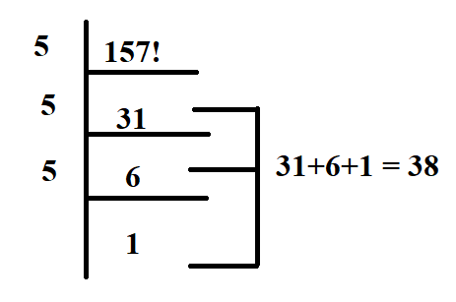
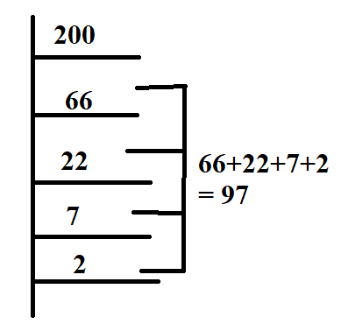
Find the maximum value of n such that 157! is perfectly divisible by 10^{n}.
Solution:
The question is otherwise stated as maximum power of 10 in 157!
10 is a composite number . 10 can be written as = 2*5
So we need to check the maximum power of 5 in 157!
So the maximum power of 10 in 157! = 38
2. Find the maximum power of 18 in 200!.
Solution:
18 = 2*3² .
Since 3² is the larger number
we need to check the maximum power of 3 in 200!
Total number of 3’s = 97
But we need 3²
so we need to divide the total number of 3’s by 2
So 97/2 = 48

Slide 17
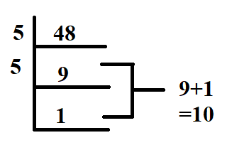
3. Find the number of zeroes at the end of 48!.
Solution:
The question is otherwise stated as maximum power of 10 in 48!
10 is a composite number . 10 can be written as = 2*5
So we need to check the maximum power of 5 in 48!
So the number of zeroes in 48! = 10

Slide 18
Section : Numerical Aptitude Topic : Number system Sub topic : Successive Division

Slide 19
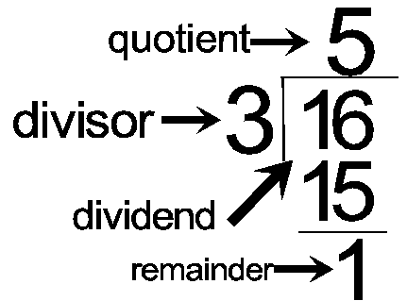
Successive division - examples
Division:
Quotient × Divisor + Remainder = Dividend
Successive Division:
In successive division each time the dividend
Changes based on the quotient obtained .
The quotient will be taken continuously
Divided by the divisors.

Slide 20
Successive division - examples
Example: 540 is successively divided by 8, 6 and 4 what will their respective remainders?
Step 1: 540 when divided by 8 . 67
8 540
48
60
56
4 – Remainder
Step 2: Now 67 should be divided by 6 , Q – 11 Remainder – 1
Step 3: Now new dividend will be 11 , 11 when divided by 4 , Quotient – 2 Remainder – 3
So their respective remainders will be 4,1,3

Slide 21
Successive division - examples
Example: A number when successively divided by 3, 4 and 9 leaves respective remainders of 2, 3 and 7. What will be the remainders if the original number is divided successively by 3, 5 and 7?
3 x
Y remainder-2
Z remainder- 3
remainder - 7
3 x
67 remainder-2
16 remainder- 3
1 remainder - 7
203
67 remainder-2
7 13 remainder- 2
1 remainder - 6
3 x
Y remainder-2
Z remainder- 3
1 remainder - 7
3 x
Y remainder-2
16 remainder- 3
1 remainder - 7
3 203
67 remainder-2
16 remainder- 3
1 remainder - 7

Slide 22

Thank you

